Slide 1
Fundamentals of Remote Sensing
L0 - Remote sensing. Introduction

Slide 2
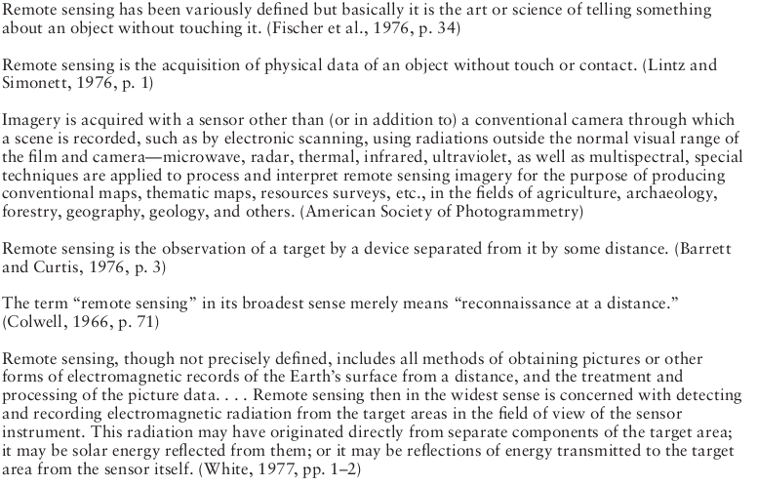
Remote sensing. Definition
(James B.Campbell, Introduction to remote sensing)

Slide 3
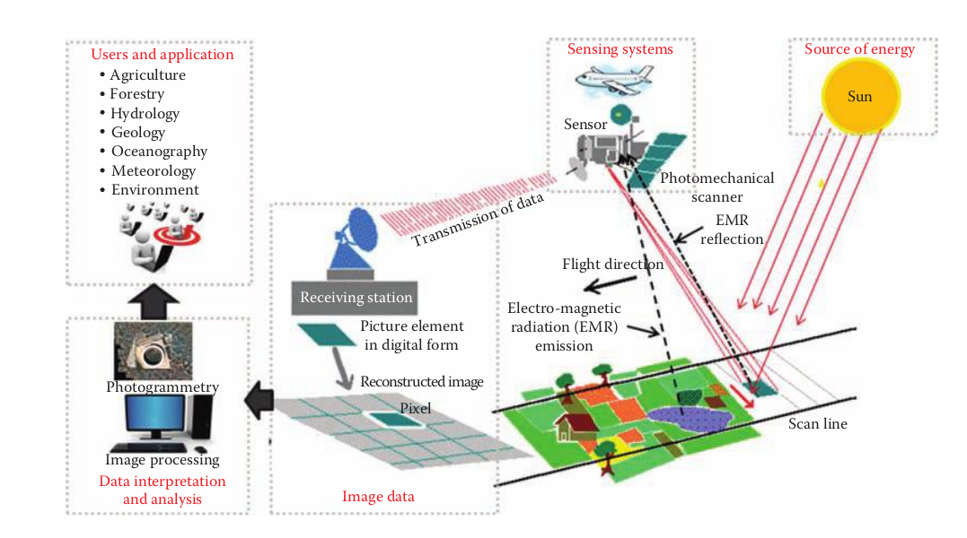
Remote sensing chain
(Thenkabail, Remote Sensing Handbook vol.1)

